Slide 1

Comparing Minimum Wages and Rent Prices in Europe
Julian Trinkl, Dania Al Khulaifi, Giorgia Tanzi, Iann Soffried, Noel Kona, Morris Nouwens
Group 5 – Tutorial 5

Slide 2
Problem Motivation and Literature
Why comparing minimum wages and rent prices is an important social issue.
Shows affordability
Highlights social inequality
Used two credible sources:
International Labour Organization (ILO, 2022)
European Union Directive on Adequate Minimum Wages (2022)
Identified a research gap:
Most studies focus on individual countries.
Few studies compare minimum wages and living costs across Europe over time.
Notes:
Why comparing minimum wages and rent prices is an important social issue.
Shows affordability: Comparing minimum wages and rent prices helps determine whether workers can afford basic housing with their earnings.
Highlights social inequality: If rent increases faster than wages, it can lead to financial hardship, homelessness, and a lower quality of life for many people.

Slide 3

Data Sourcing and Description
The three public datasets:
We used three public datasets:
Eurostat HICP dataset
Measures rent inflation.
Covers 2015–2025.
Eurostat Minimum Wage dataset
Annual statutory minimum wages.
Allows comparison between countries.
giscoR geographic dataset
European country boundaries.
Used for mapping inflation differences.
Notes:
Why these datasets?
Official European data.
Reliable and comparable across countries.
Allowed temporal and spatial analyses.
We selected Eurostat because it uses harmonized methods across countries, making comparisons more reliable and consistent.
We described:
who collected the data,
what the data measure,
the years included,
why each dataset was useful.
Acknowledged limitations, such as:
HICP reflects average price changes and does not show regional differences.
Minimum wage data only include countries with statutory minimum wages.
Missing values meant some countries could not be included.

Slide 4

Data Cleaning
We cleaned and merged the datasets before analysis.
Step 1: Remove unnecessary information
Removed metadata rows.
Deleted empty observations.
Kept only countries and years relevant to the study.
Step 2: Standardize variables
Converted HICP and wage values to numeric format.
Reshaped datasets into a country-year structure.
Created HICP percentage change (2015–2025).
Step 3: Merge datasets
Combined HICP and wage data using country and year.
Linked geographic data using country names.
Removed Bosnia, Turkey, and Albania because of missing data.
Notes:
Handled missing data: Countries with incomplete data (Like: Bosnia, Turkey, and Albania) were removed to ensure consistent comparisons across all analyses.

Slide 5

New Variables
Variable 1:
Average Minimum Wage Growth
Measures how wages changed over time.
Variable 2:
Rent Inflation Change (2015–2025)
Measures increases in housing costs.
Why?
Allows direct comparison between wages and rent prices.
Helps answer our research question.

Slide 6
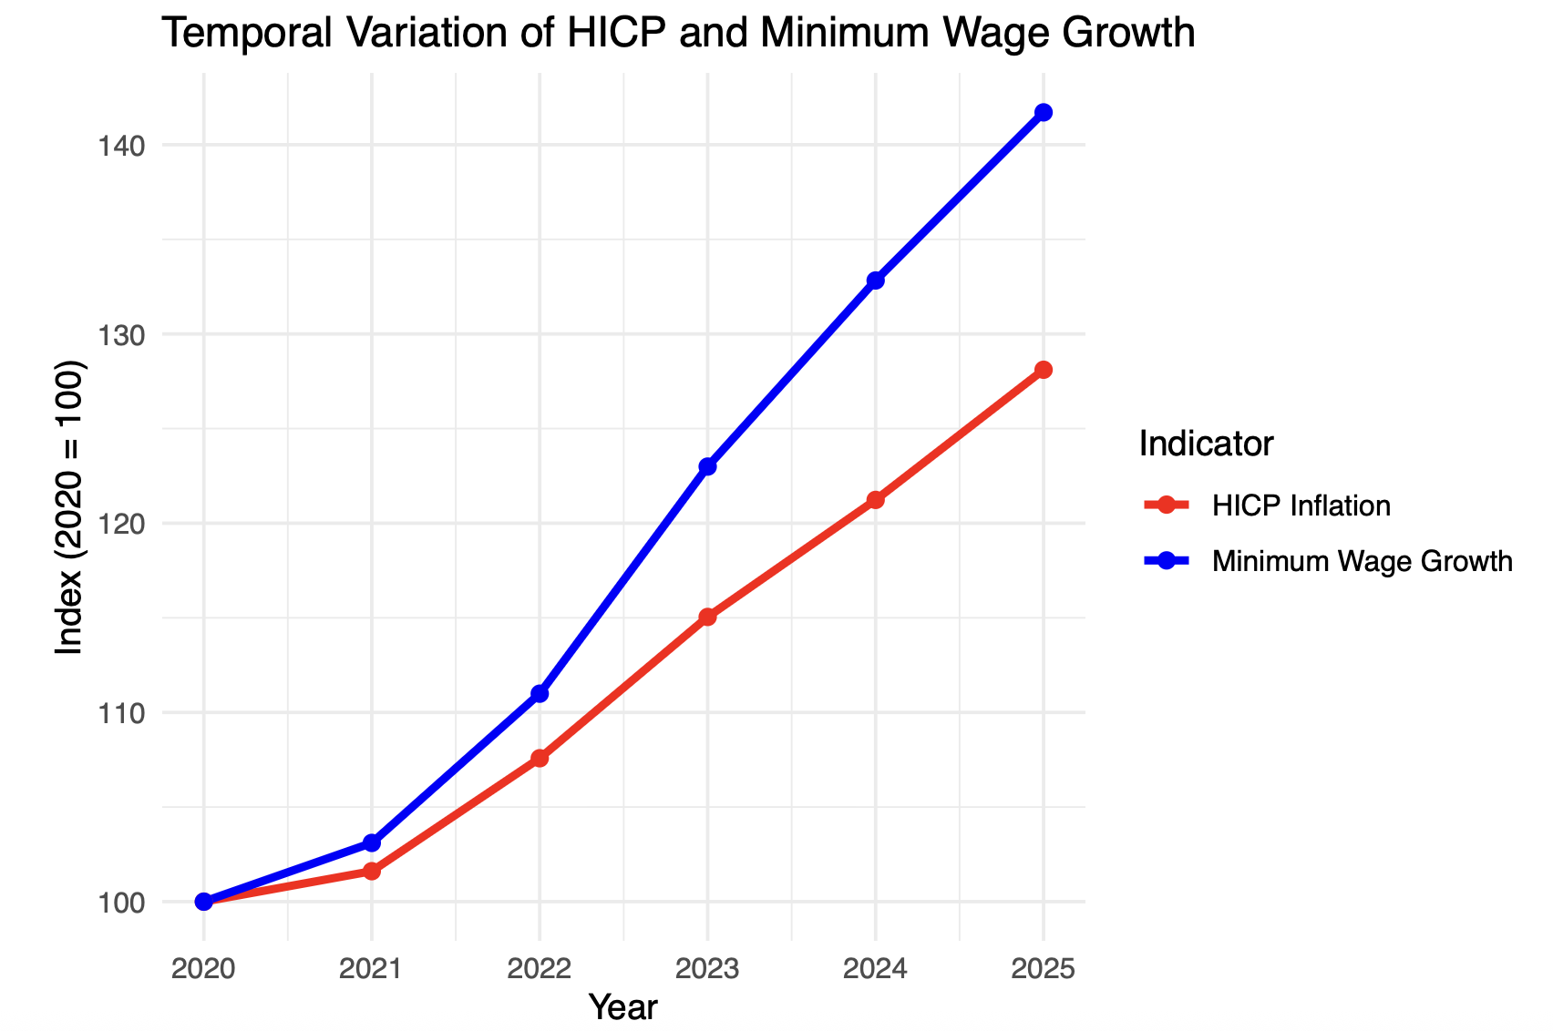
Temporal Variation
Created a time-series graph (2020–2025).
Added axis labels and legends.
Compared rent inflation with minimum wage growth.
Interpreted the trends.
Findings:
Minimum wages increased after inflation spikes.
Average wage growth generally kept pace with inflation.
Country differences still existed.

Slide 7
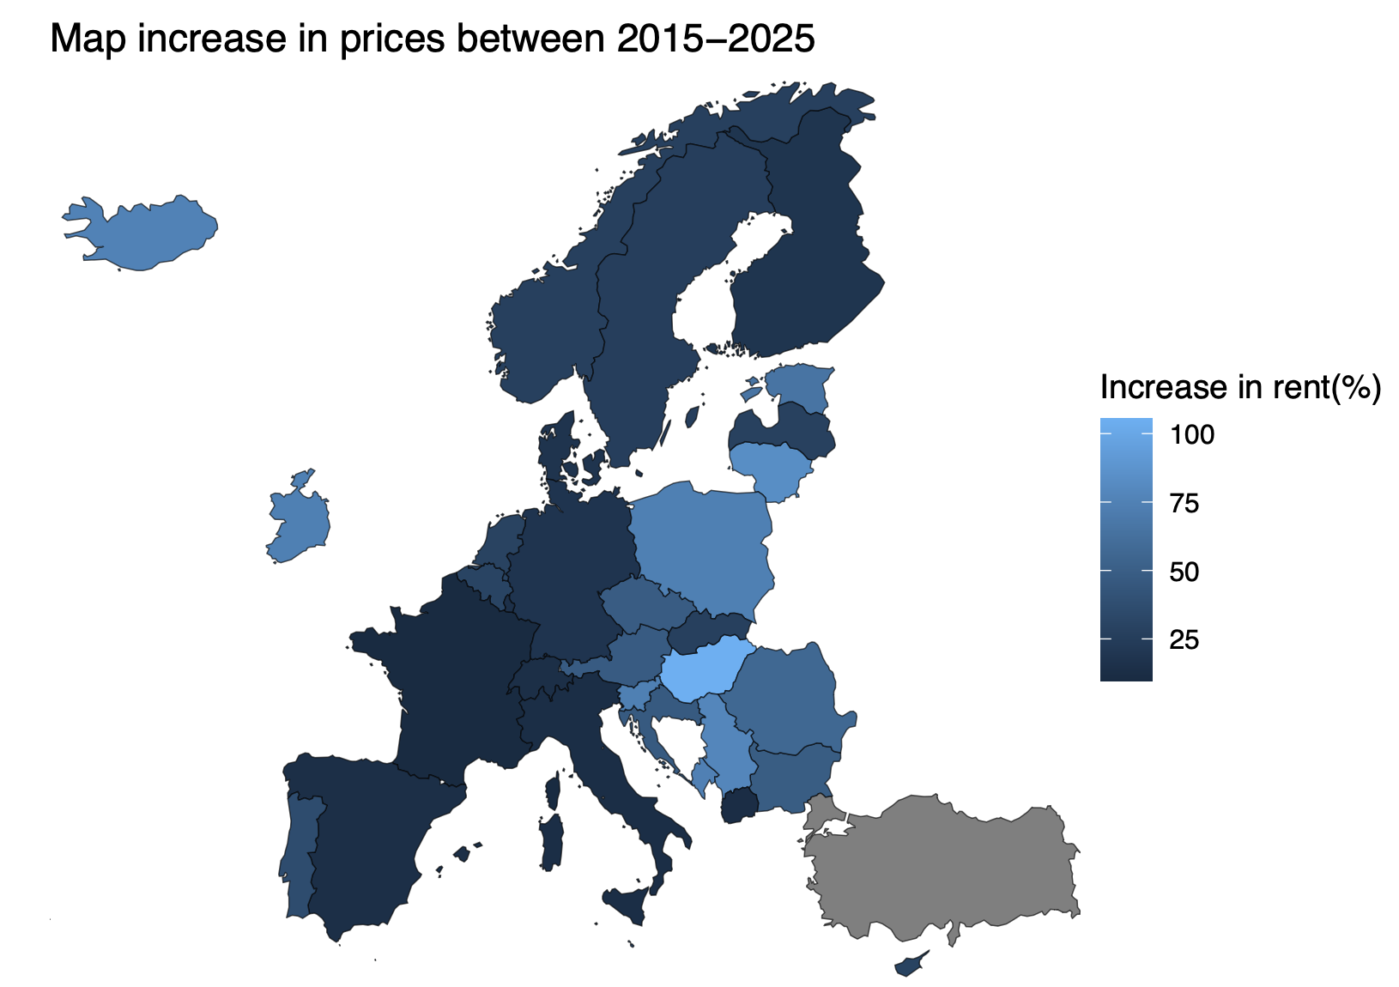
Spatial Variation
How we achieved Perfect Quality:
Created a European map showing rent inflation.
Included captions, legends, and labels.
Compared countries and regions.
Discussed mapping limitations.
Findings:
Eastern Europe experienced higher inflation.
Western Europe showed smaller increases.
Countries facing larger price increases need greater wage growth.

Slide 8
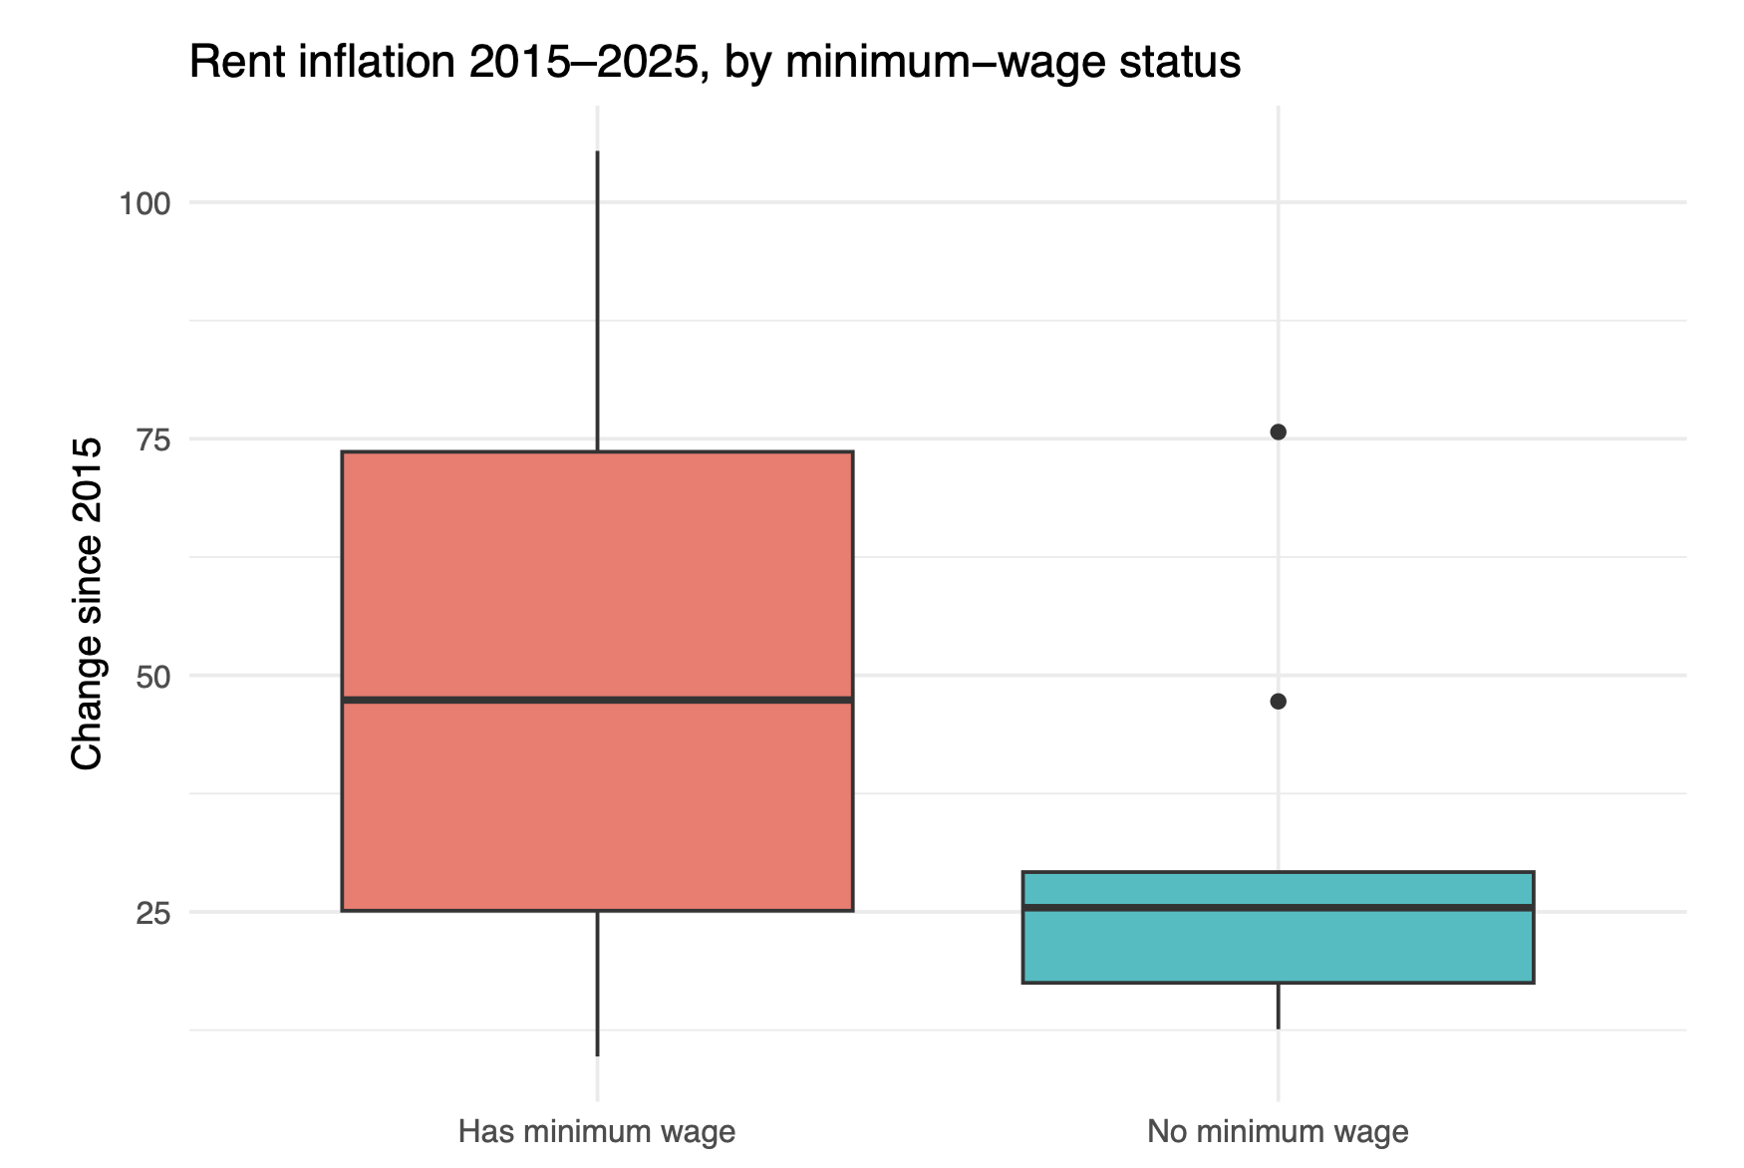
Sub-population Analysis
How we achieved Perfect Quality:
Grouped countries by:
Countries with minimum wage laws.
Countries without minimum wage laws.
Findings:
Countries with minimum wages showed higher inflation variation.
Wealthier countries without minimum wages had lower inflation.
Association does not mean causation.

Slide 9
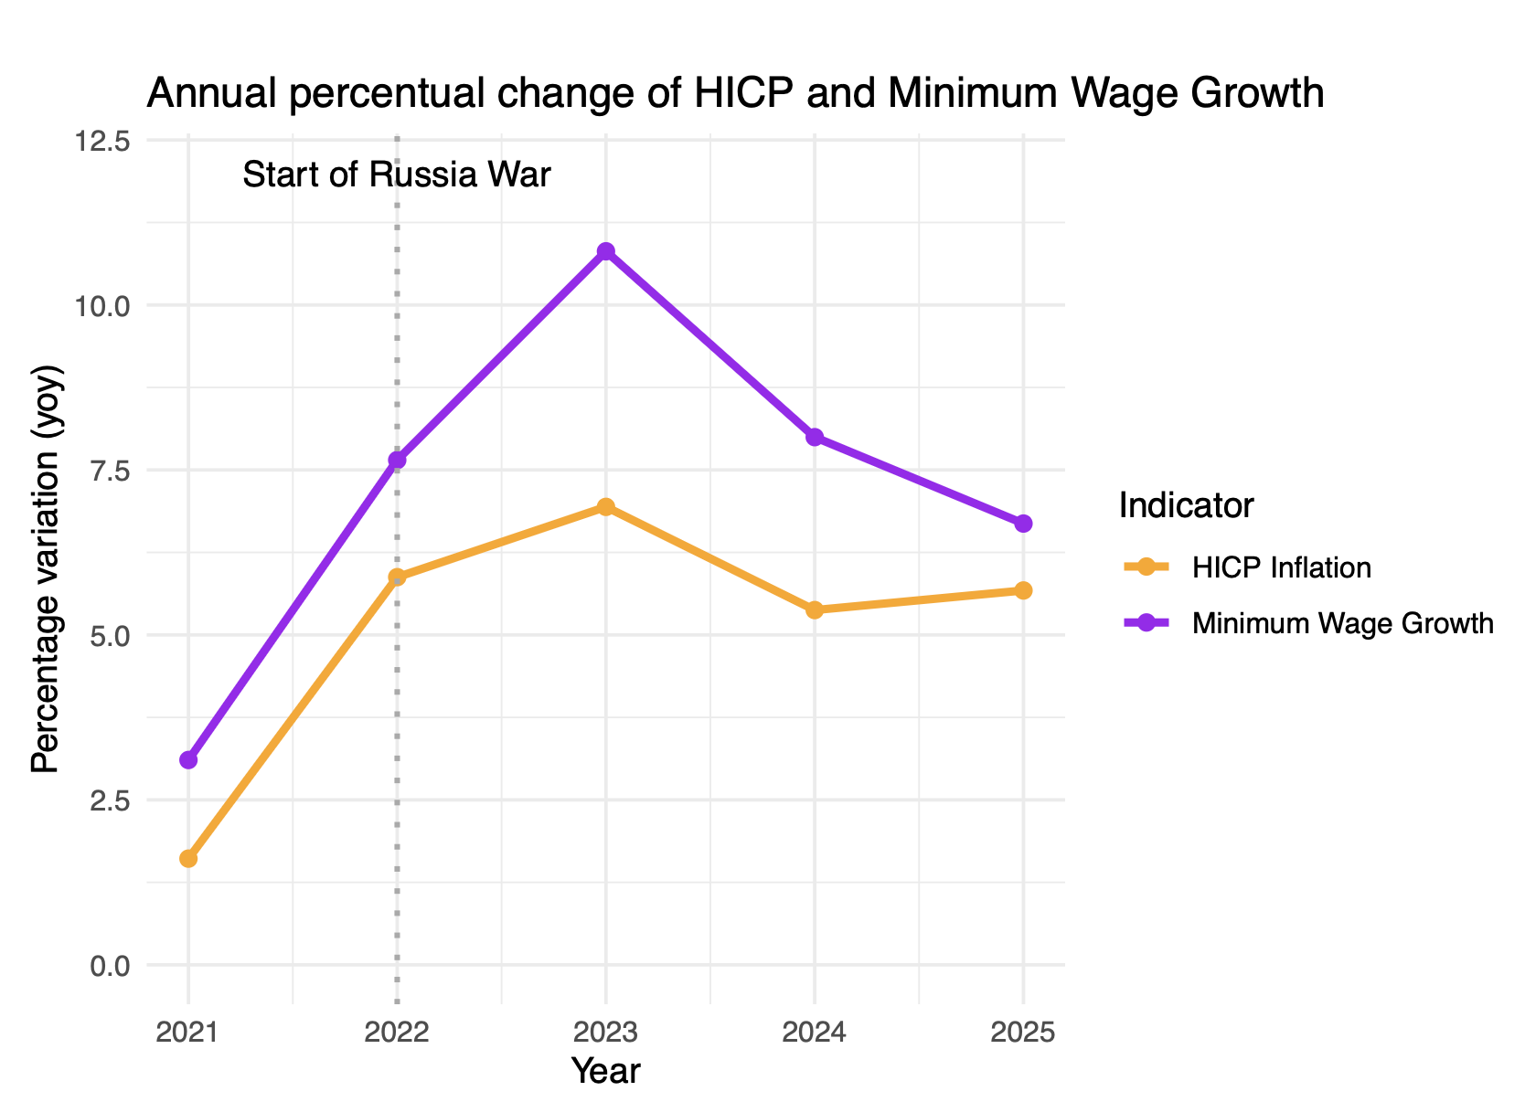
Event Association
How we achieved Perfect Quality:
Examined inflation and wage growth around major events.
Focused on the impact of the Russia–Ukraine War (2022).
Compared changes before and after the event.
Discussed limitations of causal interpretation.
Findings:
Inflation increased sharply after 2022.
Wage growth followed with some delay.

Slide 10
Reproducibility & Report
Reproducibility:
Used organized R scripts.
Stored code in GitHub.
Documented how data were downloaded.
Report Quality:
Used APA referencing.
Included figures in discussions.
Maintained a clear structure.
Conclusion:
Minimum wages often increased alongside rent prices.
However, large differences existed across Europe.

Slide 11

By carefully addressing each rubric criterion, we tried to achieve the Perfect Quality standard throughout the project.

